Slide 1

Comparing to human-level performance
Avoidable bias
deeplearning.ai

Slide 2
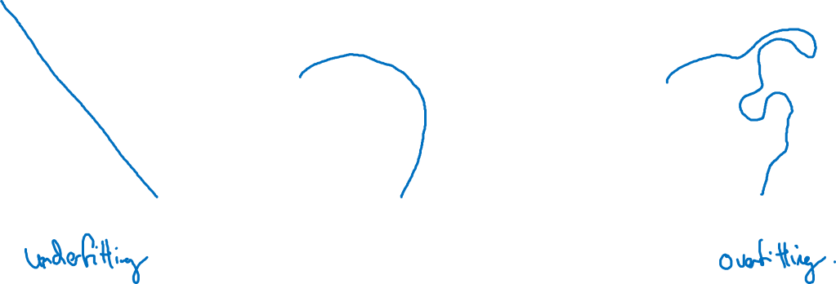
Bias and Variance
high bias
“just right”
high variance

Slide 3
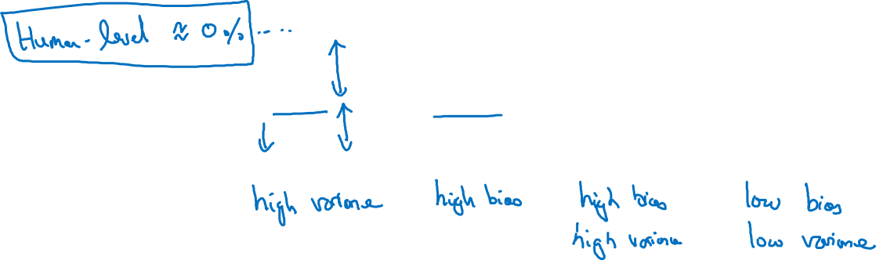
Bias and Variance
Cat classification
Training set error: 1% 15% 15% 0.5%
Dev set error: 11% 16% 30% 1%

Slide 4
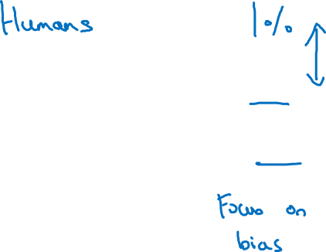
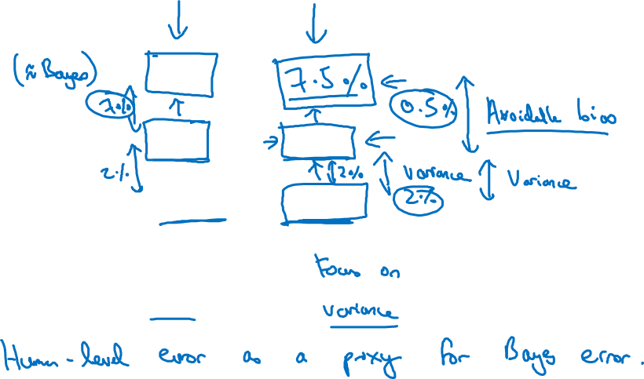
Cat classification example
Training error 8%
8 %
Dev error 10%
10 %

